Slide 1

VUNO EYE TEAM - technical summary
REFUGE2 @ MICCAI 2020

Slide 2
Outline
Glaucoma classification
Cup/Disc Segmentation
Fovea Localization
Train with a commercial ophthalmologic finding network
Train with with a pretrained network (used in previous competition)

Slide 3
Throughout all Sub-Challenges
Augmentation
Flip, affine transformation (rescale, shear, translation, rotation), image perturbation (color, contrast, brightness, sharpness, RGB shift, Gamma), noise (blur, ISO noise, Gaussian noise, JPEG compression, sunflare), elastic transform, grid transform, and down-sampling
Source code
https://bitbucket.org/woalsdnd/refuge2 (available after the final competition).

Slide 4
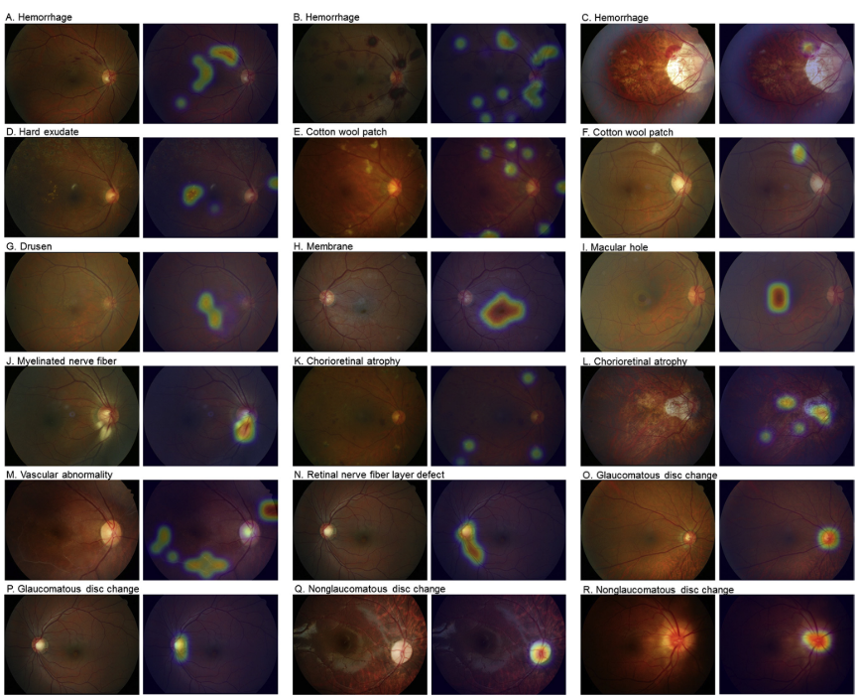
Sub-Challenge 1 | Glaucoma classification
Preparation: Finding network^{[1]} for 15 ophthalmologic findings
▲15 findings: hemorrhage, hard exudate, cotton wool patch, drusen, retinal pigmentary change, vascular abnormality, membrane, fluid accumulation, chorioretinal atrophy, choroidal lesion, myelinated nerve fiber, retinal nerve fiber layer defect, glaucomatous disc change, non-glaucomatous disc change, and macular hole.
[1] Son, Jaemin, et al. "Development and validation of deep learning models for screening multiple abnormal findings in retinal fundus images." Ophthalmology 127.1 (2020): 85-94.

Slide 5
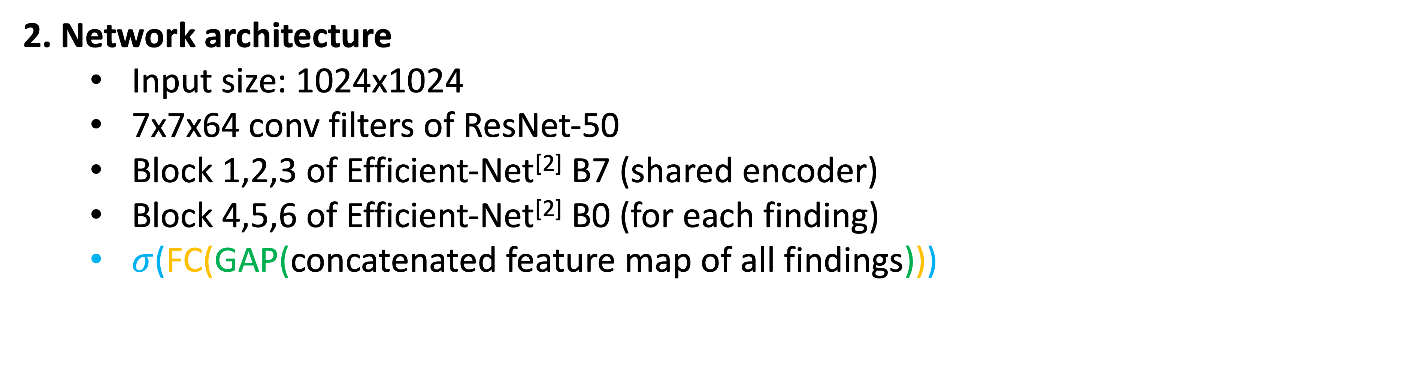
Sub-Challenge 1 | Glaucoma classification
2. Network architecture
Input size: 1024x1024
7x7x64 conv filters of ResNet-50
Block 1,2,3 of Efficient-Net^{[2]} B7 (shared encoder)
Block 4,5,6 of Efficient-Net^{[2]} B0 (for each finding)
$σ$(FC(GAP(concatenated feature map of all findings)))
Glaucoma
▲Our overall network architecture for sub-challenge 1
[2]Tan, Mingxing, and Quoc V. Le. "Efficientnet: Rethinking model scaling for convolutional neural networks." arXiv preprint arXiv:1905.11946 (2019).

Slide 6
Sub-Challenge 1 | Glaucoma classification
3. Training Details
Freezing the weights of the finding network
Optimizing the weights of the final FC layer using the given challenge data
Learning rate
Set initial value to 1e-3
Reduce by 1/10 (if validation AUROC did not improve over 10 epochs)
Set to the initial value (if the learning rate is reduced under the preset threshold)
4. Model selection & ensemble
Total 8 models with 2 preprocessing methods
Normalize fundus dividing by 255 (x/=255) – 4 models through CV
Set local mean to zero (Kaggle 2015 winner’s method) – 4 models through CV
Average outputs of the 8 models

Slide 7
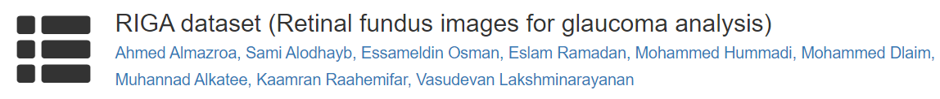



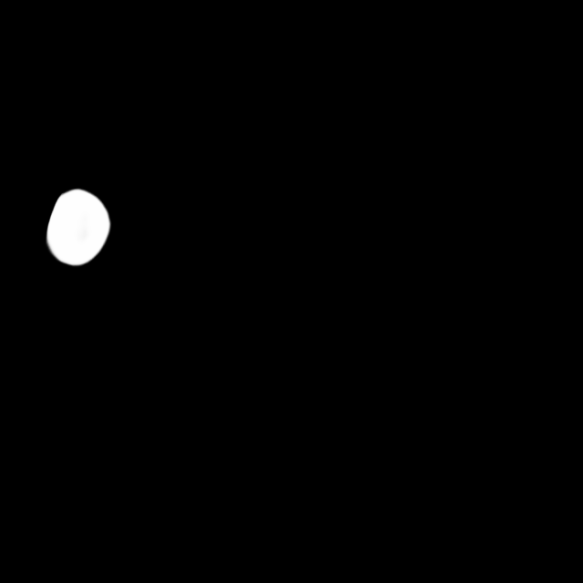

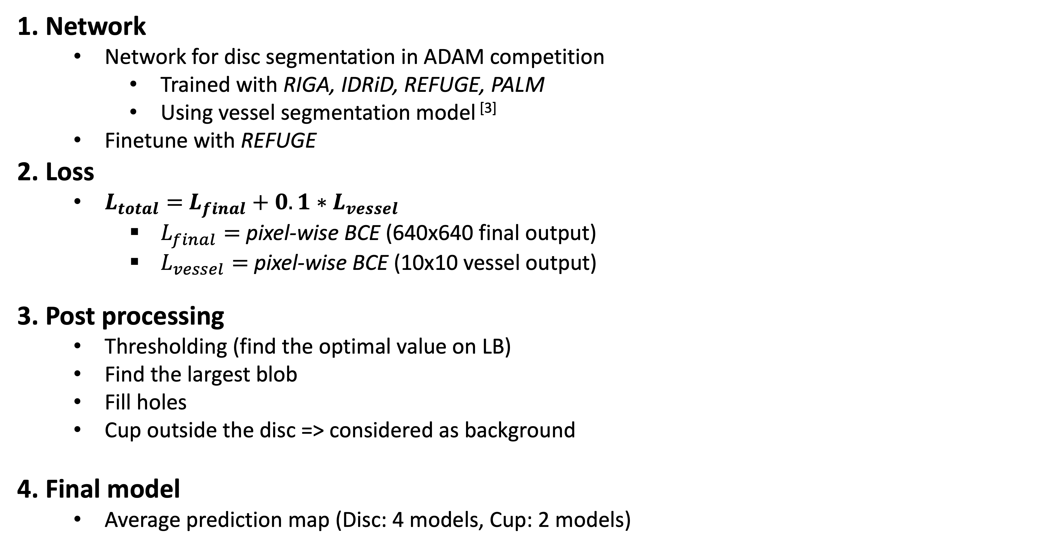
Sub-Challenge 2 | Cup/Disc segmentation
1. Network
Network for disc segmentation in ADAM competition
Trained with RIGA, IDRiD, REFUGE, PALM
Using vessel segmentation model ^{[3]}
Finetune with REFUGE
2. Loss
$L_{total}=$ $L_{final}+0.1∗L_{vessel}$
$L_{final}=$ pixel-wise BCE (640x640 final output)
$L_{vessel}=$ pixel-wise BCE (10x10 vessel output)
3. Post processing
Thresholding (find the optimal value on LB)
Find the largest blob
Fill holes
Cup outside the disc => considered as background
4. Final model
Average prediction map (Disc: 4 models, Cup: 2 models)
…
[3] Son, Jaemin, Sang Jun Park, and Kyu-Hwan Jung. "Towards accurate segmentation of retinal vessels and the optic disc in fundoscopic images with generative adversarial networks." Journal of digital imaging 32.3 (2019): 499-512.

Slide 8
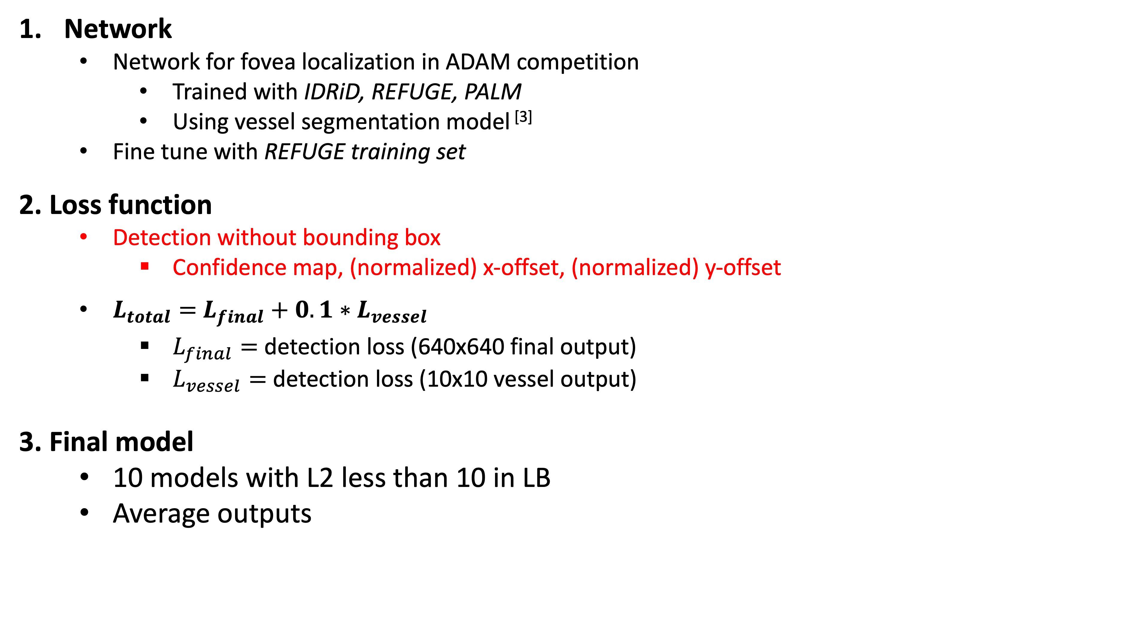
Sub-Challenge 3 | Fovea Localization
Confidence map
Network
Network for fovea localization in ADAM competition
Trained with IDRiD, REFUGE, PALM
Using vessel segmentation model ^{[3]}
Fine tune with REFUGE training set
2. Loss function
Detection without bounding box
Confidence map, (normalized) x-offset, (normalized) y-offset
$L_{total}=$ $L_{final}+0.1∗L_{vessel}$
$L_{final}=$ detection loss (640x640 final output)
$L_{vessel}=$ detection loss (10x10 vessel output)
3. Final model
10 models with L2 less than 10 in LB
Average outputs
X-offset map
Y-offset map
…
Confidence map
X-offset map
Y-offset map

Slide 9
Take-Home Message
Glaucoma classification can be implemented with reliable representation networks
Fovea localization can be solved by detection without bounding box.
Retinal vasculatures provide useful information about the location of fovea and disc, and vessel segmentation can be actively used for fovea localization and disc segmentation.

Slide 10
Thank you!
Contact woalsdnd@vuno.co for any questions!
T 02.515.6646
E hello@vuno.co
H www.vuno.co

